Slide 1
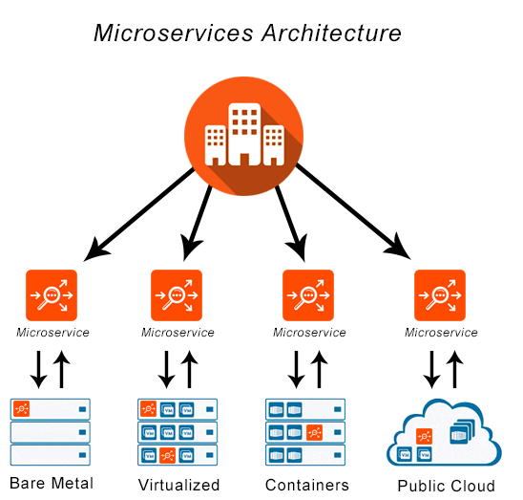
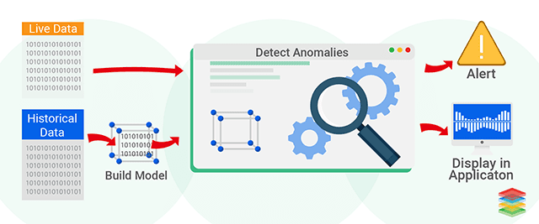
Using Machine Learning to detect and diagnose Anomalies in Microservices

Slide 2
Content Overview
What's the project about?
What problems are we trying to address?
Aim and Objectives
Planning
Risks
Future Development

Slide 3
What's the project about?
Use data produced by monitoring microservices to train machine learning models to detect anomalies
Machine learning techniques such as Decision Trees, Random Forests and Support Vector Machines
Decision Tree
Random Forests
DATASET
Tree-1
Tree-2
Tree-3
Class Normal
Class Anomaly
Class Normal
Majority Vote = Class Normal
Notes:
Techniques will most likely change as more research is conducted

Slide 4
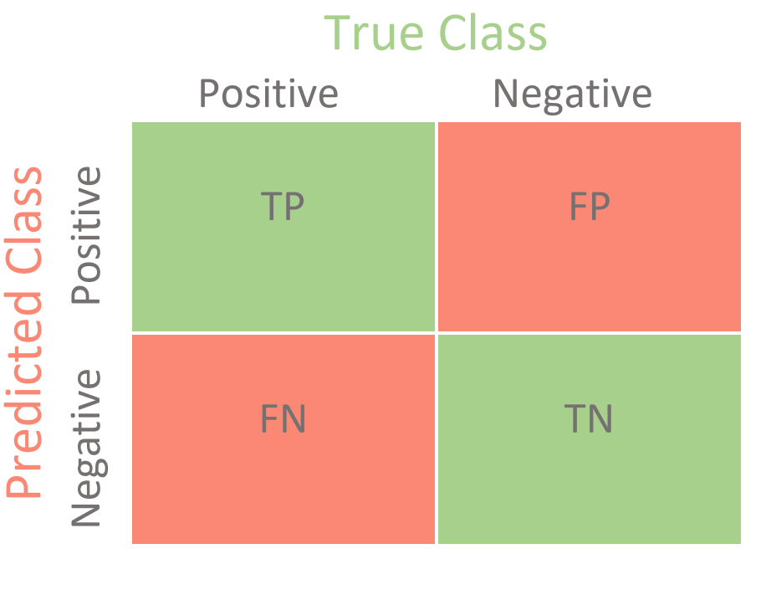
What's the project about?
Evaluate and compare the techniques using the Confusion Matrix to determine;
Accuracy
Precision
Recall
F1 Score

Slide 5
What problems are we trying to address?
Problems
Public clouds such as AWS rely on services like CloudWatch for monitoring anomalies
With the emergence of hybrid clouds (private and public) platform specific tools become less effective
Scale and Complexity has dramatically increased over the years with each node differing in configuration, software and hardware.
Solution
Create research to back a non-platform specific adaptive tool, which can be deployed
Notes:
Hope the research in this paper can aid the anomaly detecting tool
Talked about a lot lets narrow down the project into a aim and objectives

Slide 6
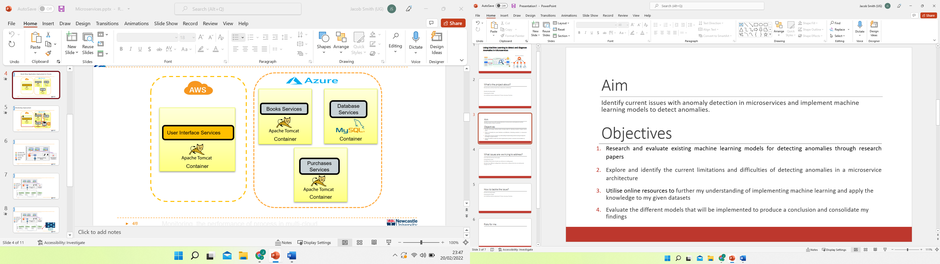
Objectives
Aim
Identify current issues with anomaly detection in microservices and implement appropriate machine learning techniques to detect anomalies.
Research existing machine learning models for detecting anomalies through research papers
Explore and identify the current limitations and difficulties of detecting anomalies in a microservice architecture
Utilise online resources to implement machine learning techniques on my given datasets
Train and test machine learning models to improve the results
Evaluate the different techniques to produce a conclusion and consolidate my findings

Slide 7
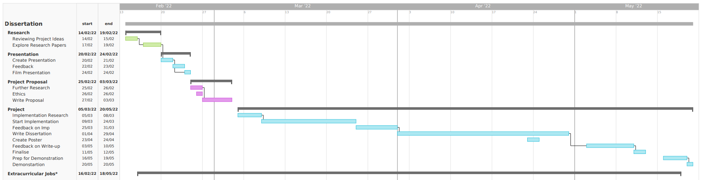
Plan
*Work 9am-5pm every Wednesday and a 3 hour shift on another day every week

Slide 8
Risks to the Plan
May not be able to complete the allocated work on time due to extracurricular work
Implementation could take longer than planned

Slide 9
Future Development
Train more models using supervised, unsupervised and deep learning techniques.
Use the findings to create a real time tool that can detect anomalies as they happen.
Deploy the real time tool into a private cloud to monitor and alert developers.

Slide 10
Summary
Detect Anomalies using Machine Learning on a specific dataset produced by monitoring Microservices
Compare Machine Learning techniques through the Confusion Matrix
Follow a waterfall methodology for the entire dissertation while working in a Agile way through implementation

